Slide 1

Bank System
(Server-Client)

Slide 2
Class Diagram

Slide 3
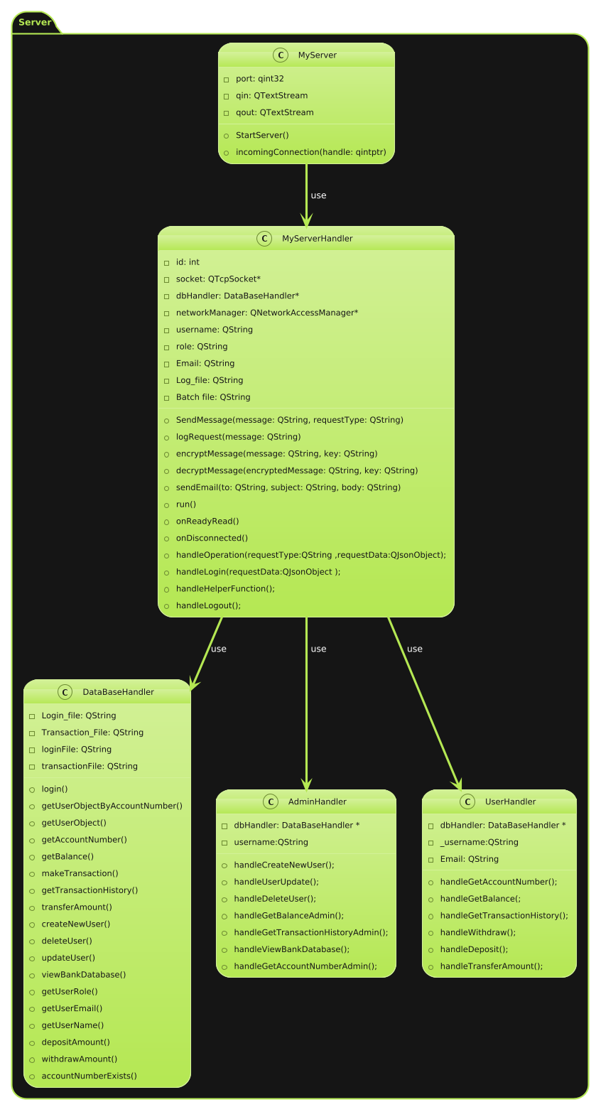
Server Class Diagram

Slide 4
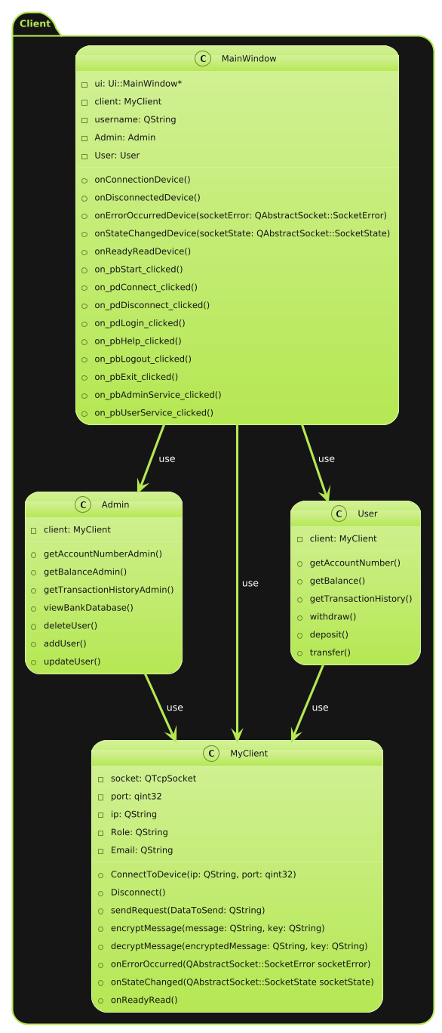
Client Class Diagram

Slide 5
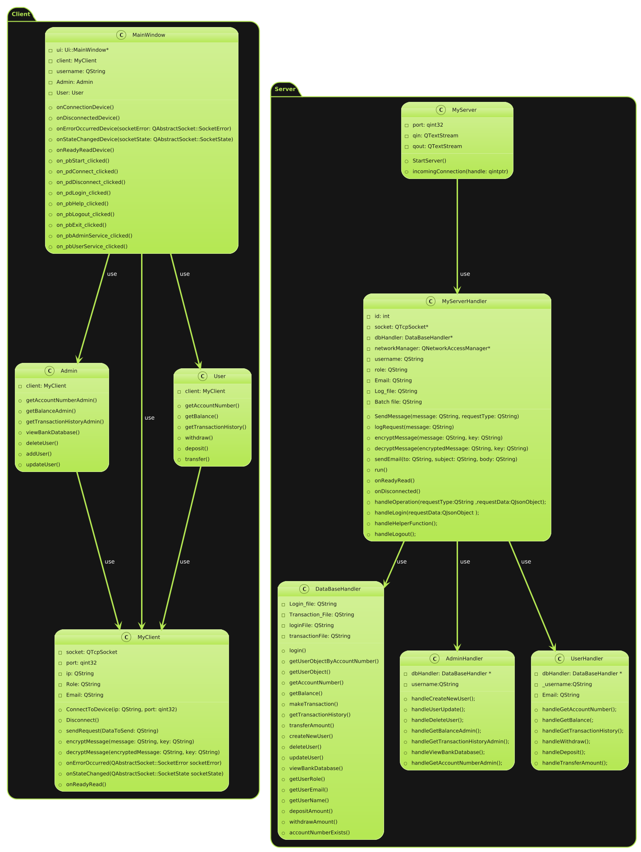
Complete Class Diagram

Slide 6
Sequence Diagram

Slide 7
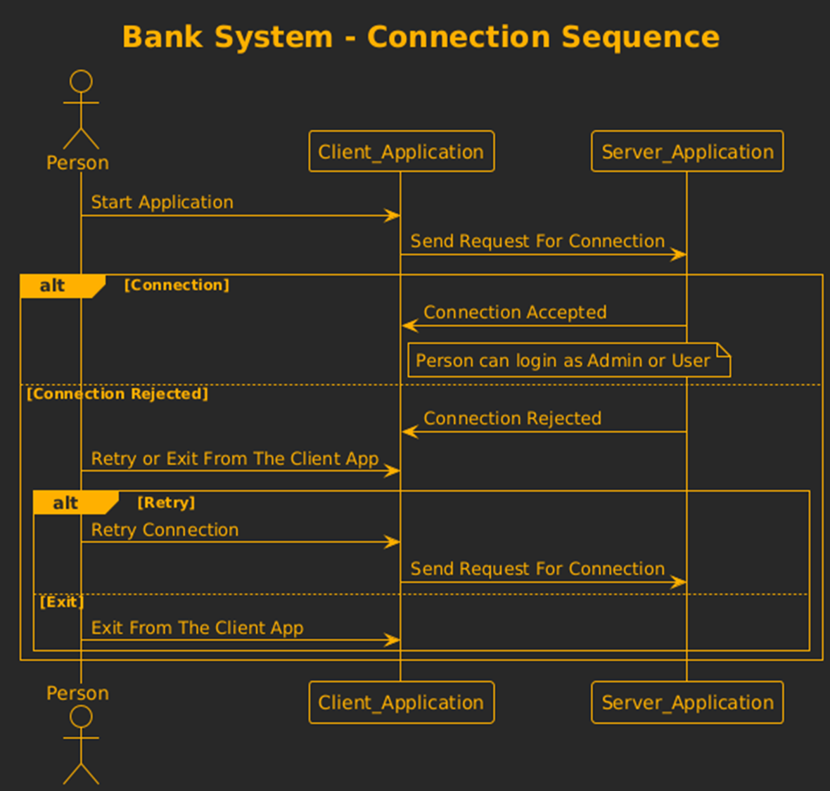
Connection sequence Diagram

Slide 8
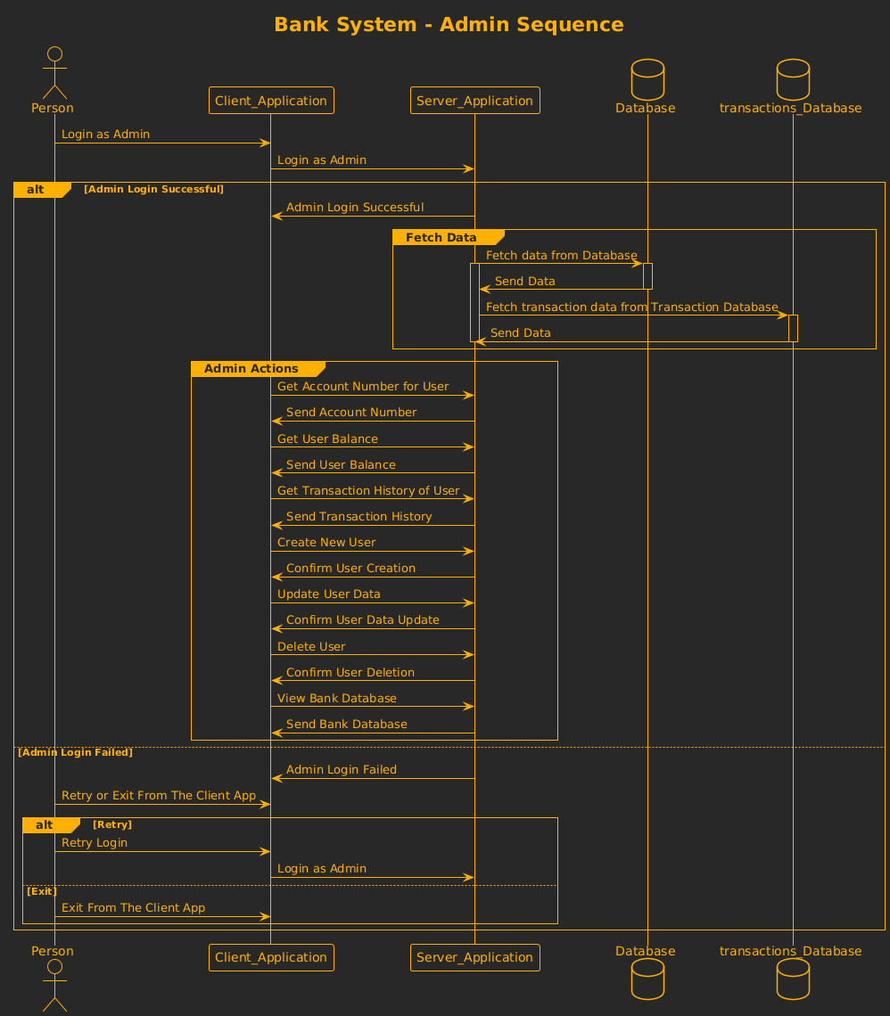
Admin sequence Diagram

Slide 9
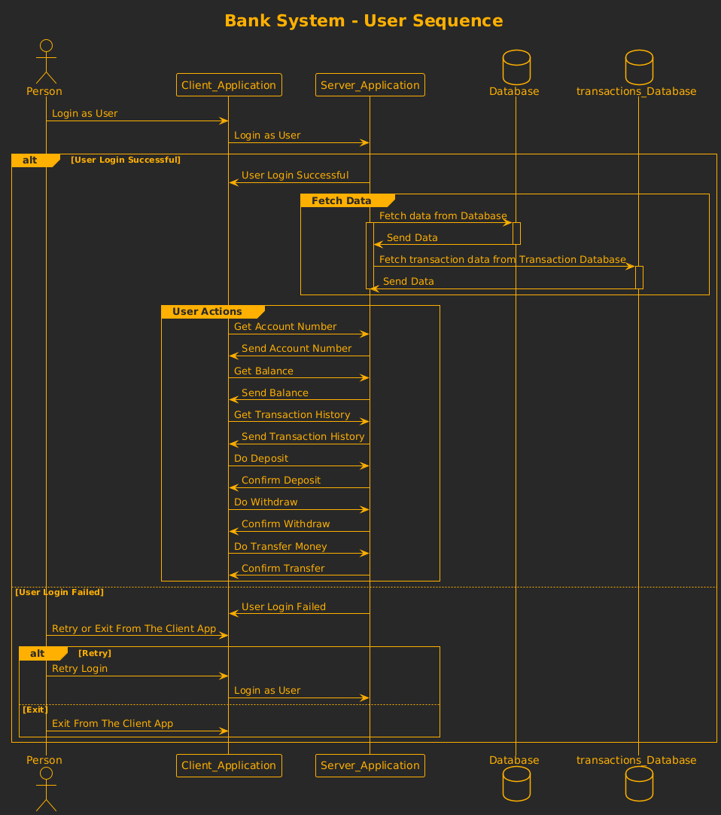
User sequence Diagram

Slide 10
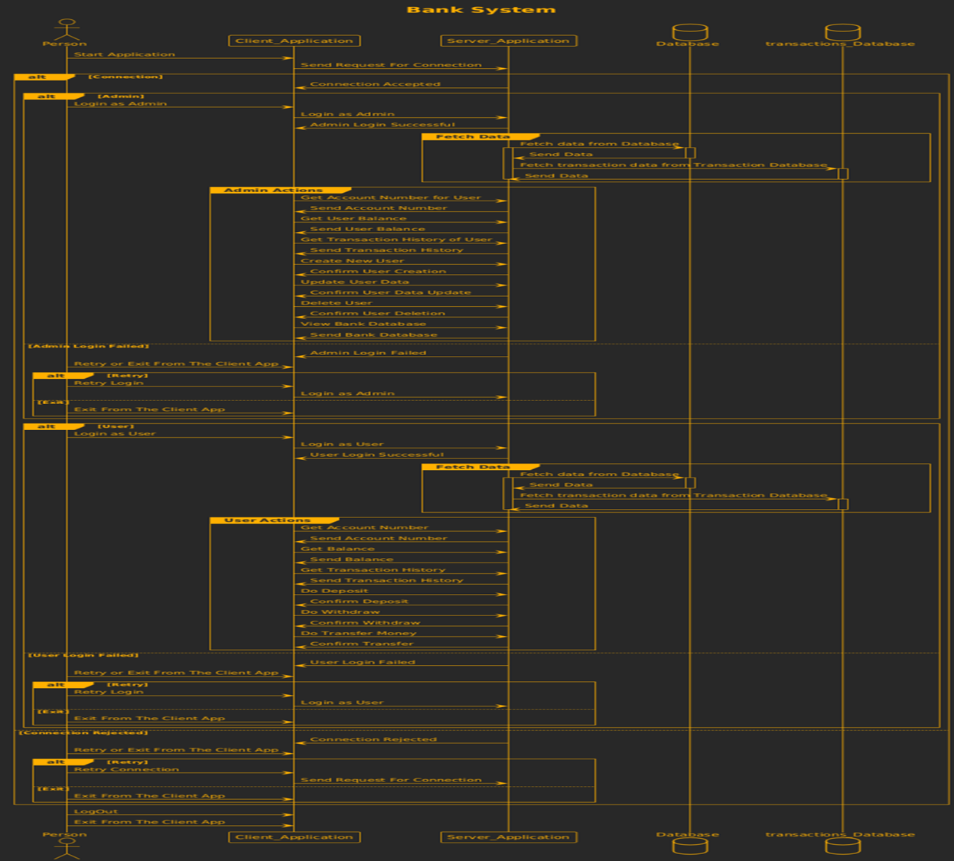
Complete sequence Diagram

Slide 11
State Diagram

Slide 12
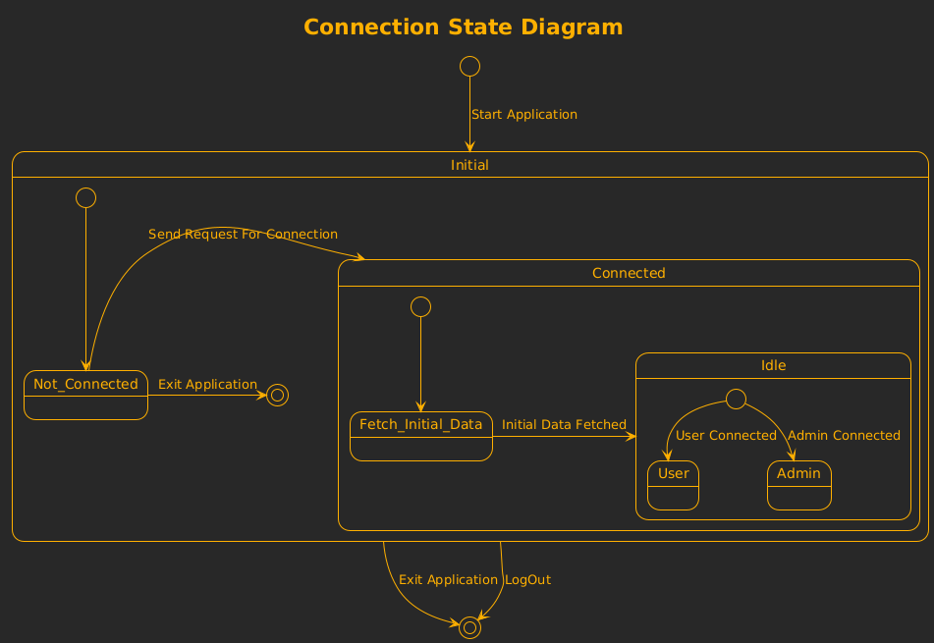
Connection State Diagram

Slide 13
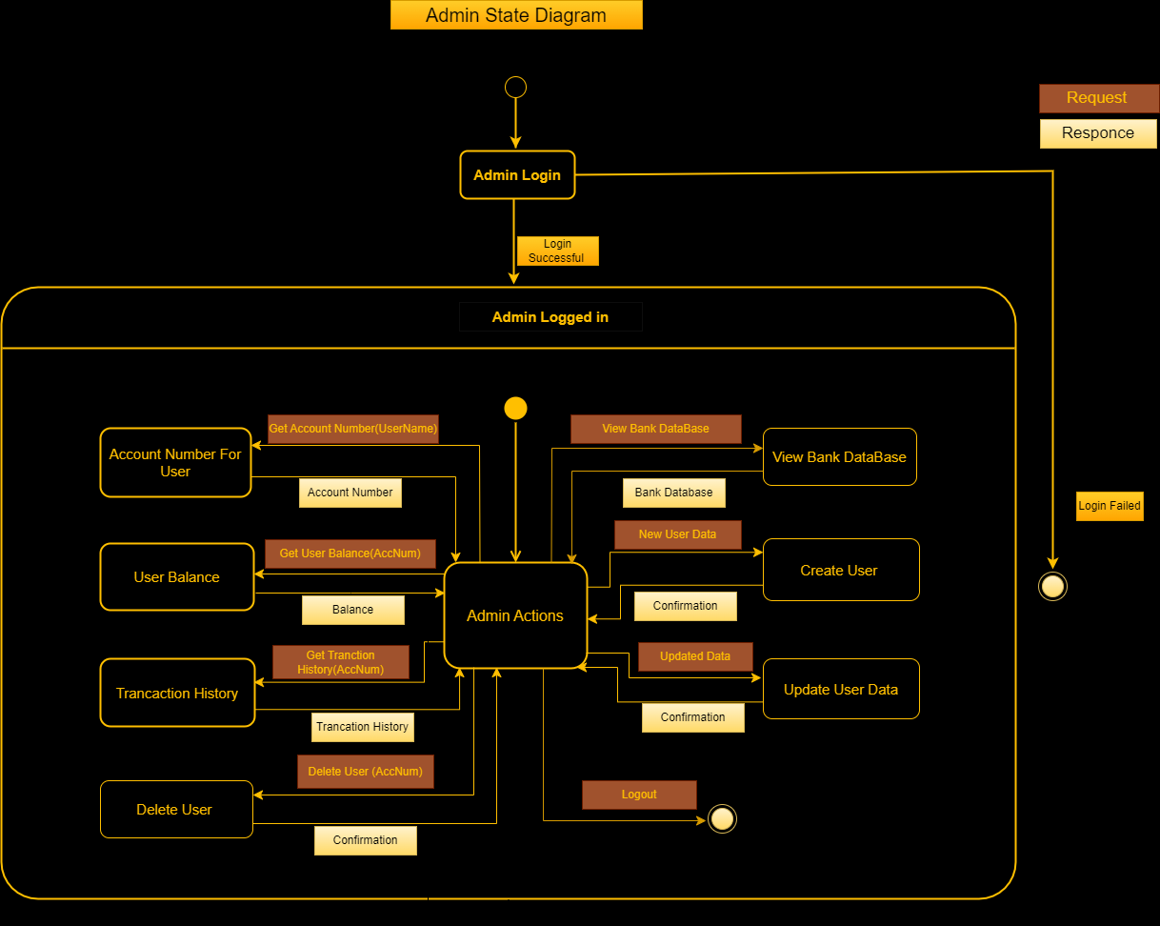
Admin State Diagram

Slide 14
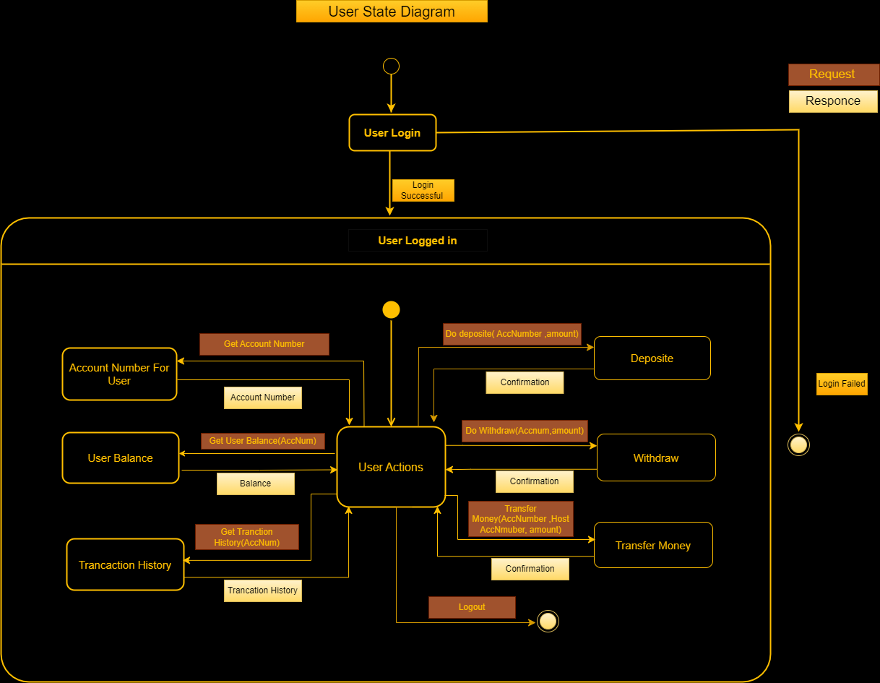
User State Diagram

Slide 15
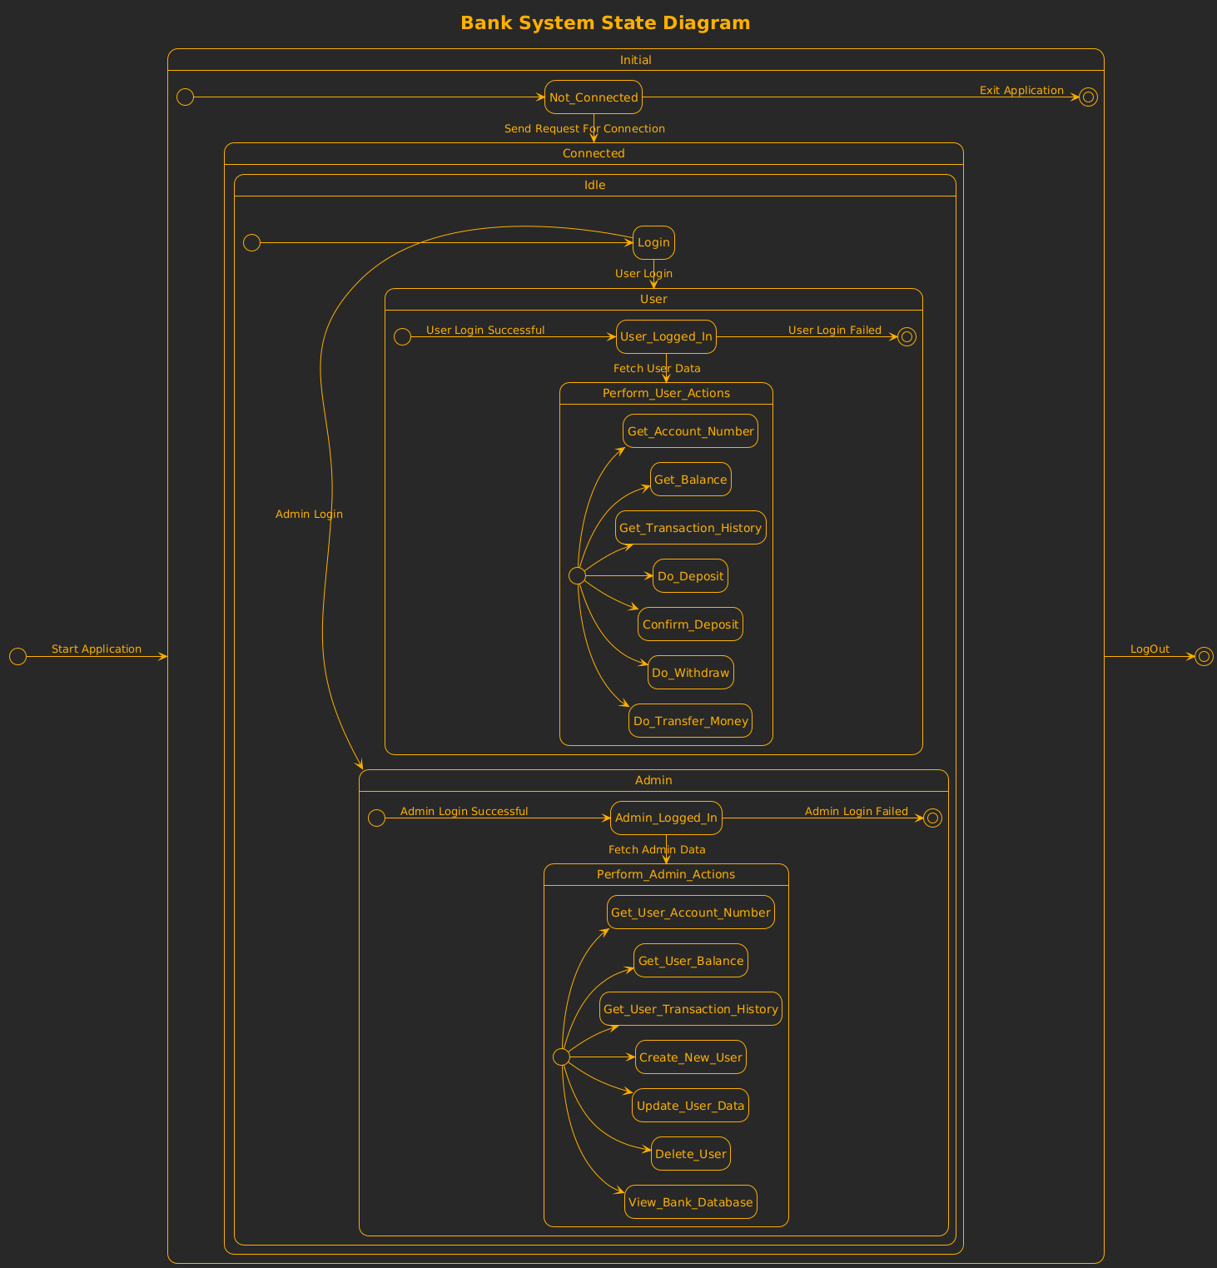
Complete State Diagram

Slide 16
The End

